Slide 1

Slide 1
Project Week 4: Data Visualization
Colin Tran

Slide 2

Agenda
Project Flow Structure
Showing the results
Biggest Challenges

Slide 3

Project Flow Structure

Slide 4
Step 1: Overview the data set
The dataset consisted of a table of Airbnb listings in New York from 2008 to 2014
There are 4 key factors in the table :
Step 2: Identify categories and numerical variables
Using variables that help for the analysis
Room Type
Beds
Price
Neighbourhood
Host since
Step 3: Generate questions:
What is the most popular Airbnb property type in New York city?
What factors influence Airbnb’s profitability?
How many cluster do we have based on the factors and which cluster has the highest profit?
What is the profit trend over the year and forecasting?
Step 4: Create data visualization:
Have an in-depth data analyze by visualization
Discover significant patterns and tendencie

Slide 5
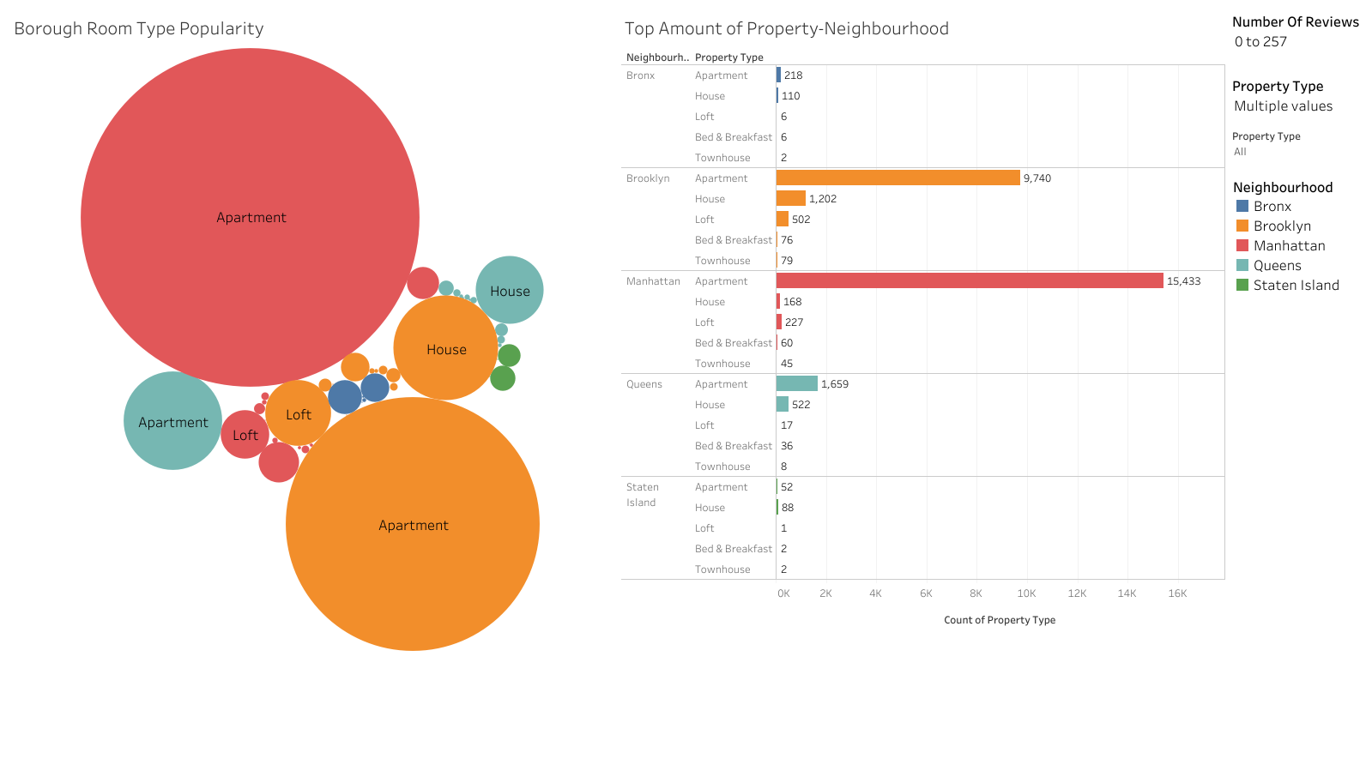

Slide 6
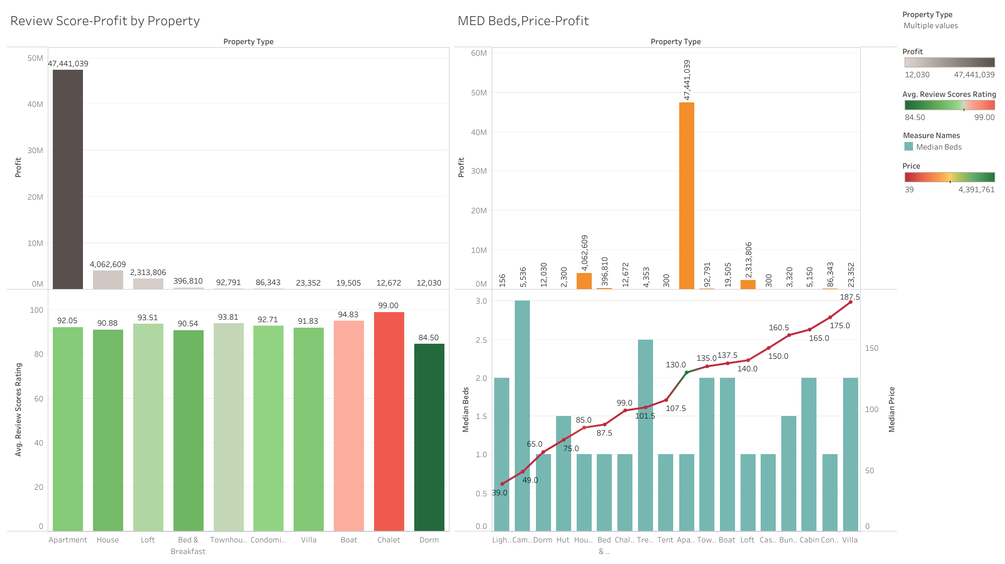

Slide 7
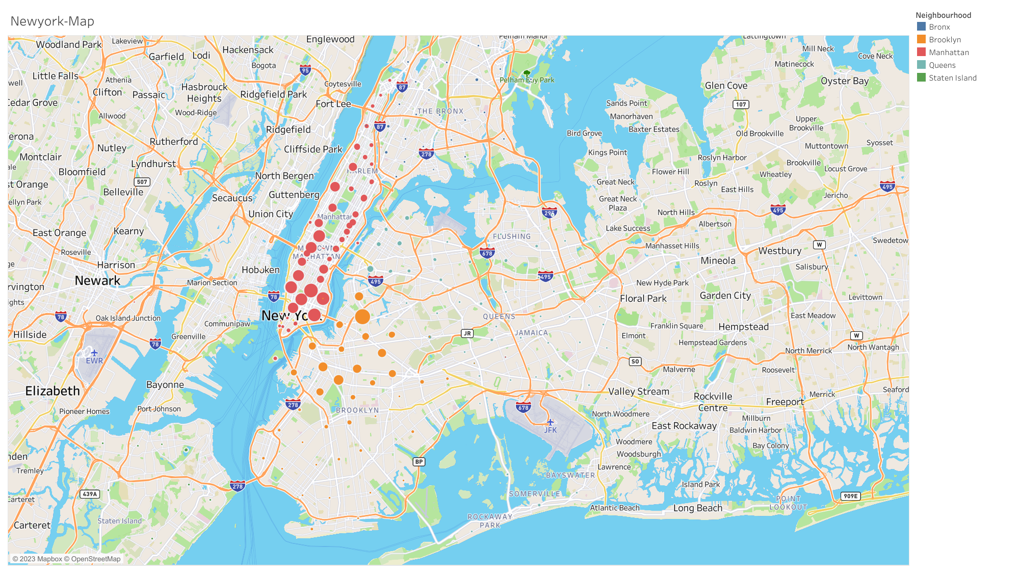
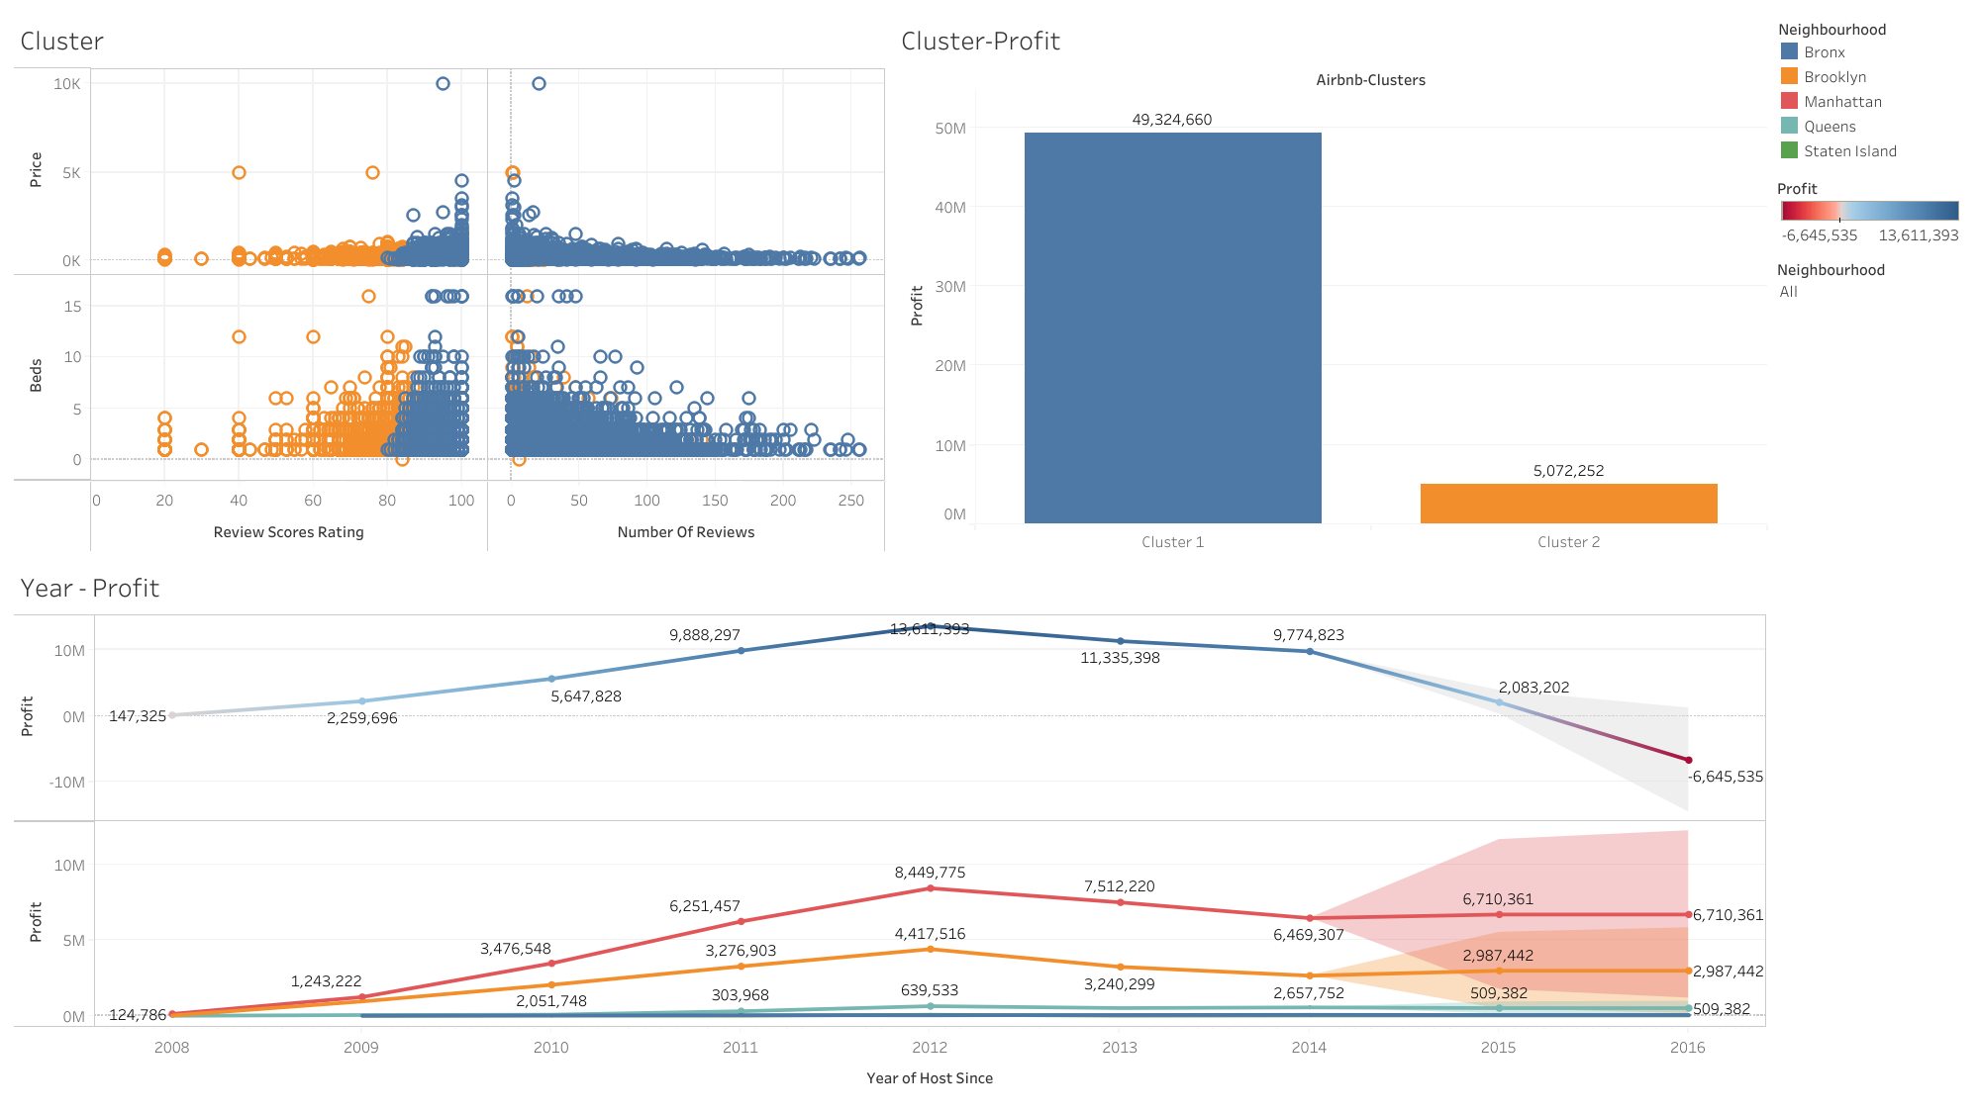

Slide 8
Summarize
Apartment is the most popular property type in New York which also has the highest number of review
There are 5 factors that influence Airbnb’s profitability: number of review and review score, property price, number of bed and location
Manhattan and Brooklyn have the largest concentration of Airbnb properties and generate the highest revenue for Airbnb among the five boroughs of New York City.
Starting in 2013, profit started to decline dramatically and is expected to decrease further due to regulatory issues and hosts listing illegally

Slide 9

Thank you
Thank you for your attention

